Slide 1
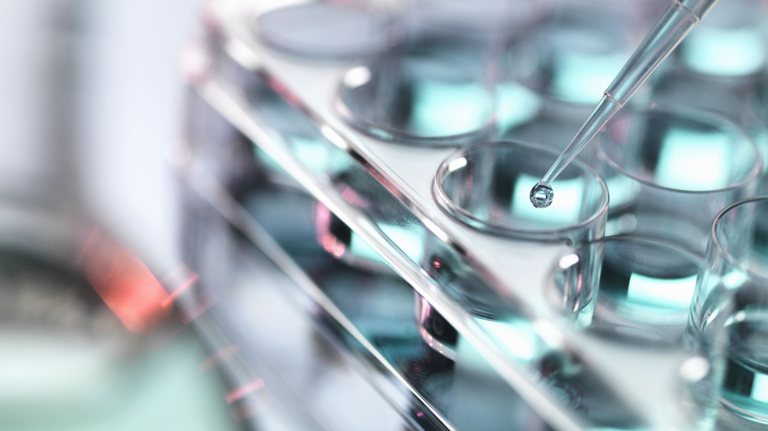
Role of kinases MAP2K1, PDHK and NEK1 on Hedgehog Signaling Activation
Paige Halas
Atwood Lab Rotation Wrap Up
December 6, 2019

Slide 2
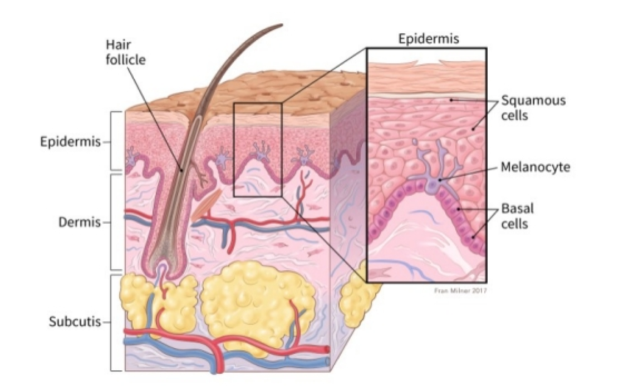
Basal Cell Carcinoma
Annual Skin Cancer Diagnosis in the US
American Cancer Society
Notes:
Basal Cell Carcinoma is the most prevalent skin cancer in the US with 4 million diagnosis a year. This cancer occurs in the basal layer which is the lowest layer of the epidermis and is most common on sun-exposed areas of the body. Evidence supports that BCC caused by uncontrolled activation of the hedgehog signaling pathway which is critical in development in the primary cilia of a cell.

Slide 3
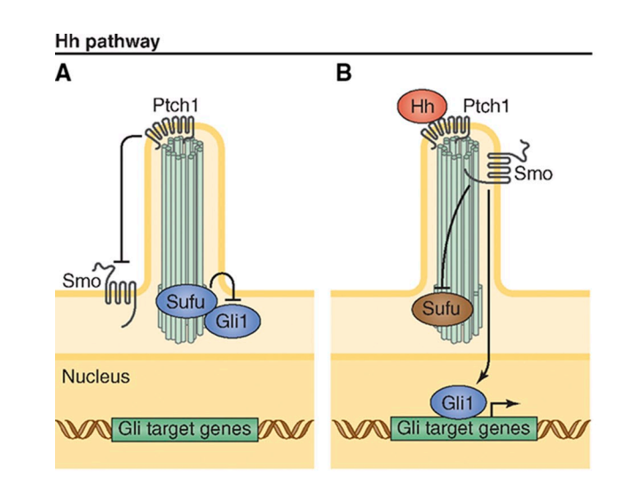
Hedgehog Signaling Pathway
Atwood et al., 2012
Notes:
Inactive Hh pathway and B. active Hh pathway
Inactive HH pathway, Patched receptor inhibits smoothened and Sufu inhibits Gli transcription pathway
When HH ligand binds to patched receptor activating the signal transducer Smoothened (SMO). SMO then moves to the cilium where it binds and inhibits Suppressor of Fused (SUFU), resulting in transcription factor activation of Glioma-Associated Oncogene (GLI)

Slide 4
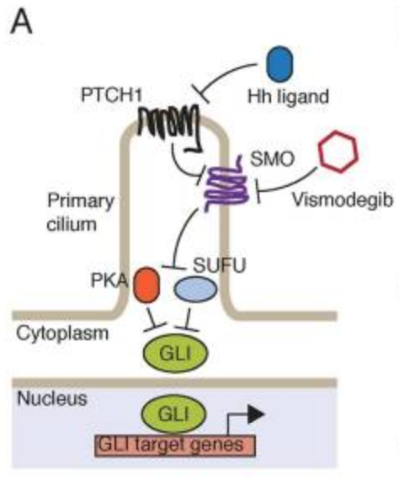
Inhibition of SMO to treat BCC
Sharpe et al., 2015

Slide 5
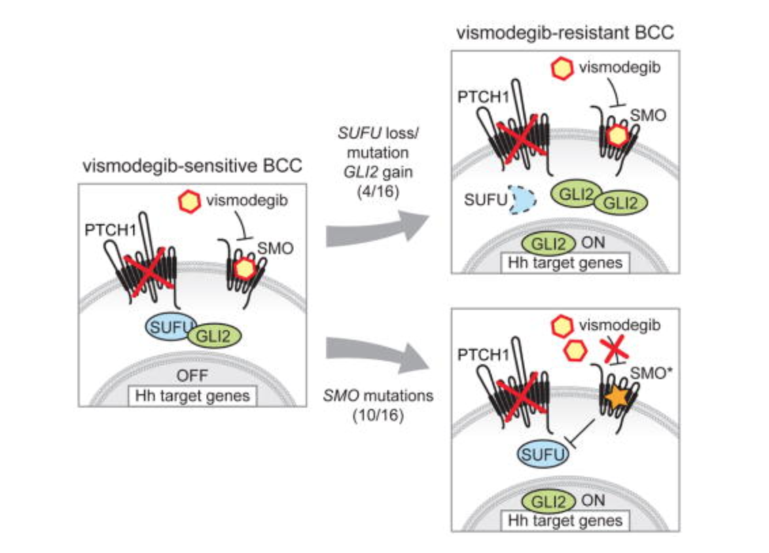
Inhibition of SMO to treat BCC
Sharpe et al., 2015
Notes:
As a method for treating BCC, small molecule drugs such as vismodegib have been designed to inhibit smoothened. When smoothened is inhibited, the release of GLI transcription factors cannot occur and thus Hedgehog target genes cannot be transcribed. However, it has been found that BCC can acquire resistance to SMO inhibitors thus causing a loss of SMO inhibitor Sufu or the gain of more transcription factors in the system. Additionally, mutations in SMO have caused the drug to be ineffective in suppressing SMO and thus allowing the pathway to proceed as normal. Both BCC resistance and SMO mutations have directed the attention in drug development to the GLI transcription factors. These transcription factors have been proposed to be activated by kinases.

Slide 6
Specific Aims and Hypothesis

Slide 7
Inhibition of SMO to treat BCC
Kinase
Regulated
Sharpe et al., 2015

Slide 8
Kinases Active at Re-current GLI Mutations
Kinase | Significance | Inhibitor
Mitogen-Activated Protein Kinase 2 (MAP2K1/MEK1) | Melanoma and metastasis Stabilizes GLI and activates Hedgehog Signaling | Cobimetinib IC50 4.2 nM
Pyruvate Dehydrogenase Kinase (PDHK) | Regulates glycolysis Inhibition upregulates apoptosis | Dichloroacetic Acid IC50 81.03 mM
NIMA Related Kinase (NEK1) | Role in ciliogenesis Activates GLI and Hedgehog Signaling | Zinc05007751 IC50 3.4 μM

Slide 9
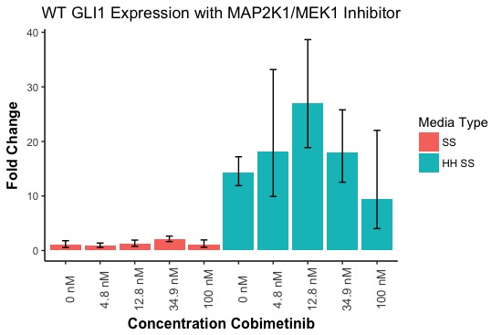
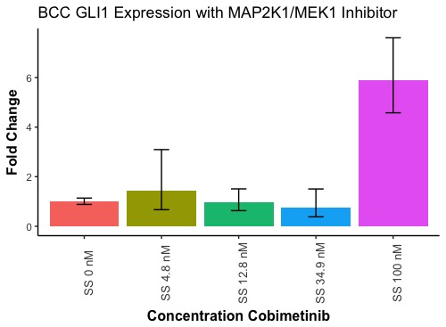
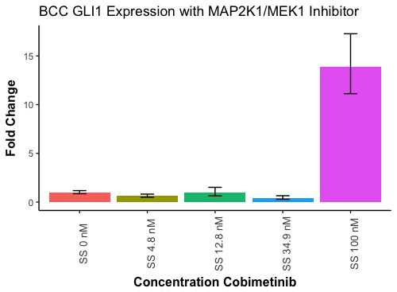
MAP2K1/MEK1 inhibition does not impact Hedgehog Signaling Activation
Wild Type (3T3)
BCC
Notes:
We observe increased Gli expression in hedgehog conditioned serum starved media as expected because the Hedgehog pathway is specifically activated.
Outlier BCC (still outlier that whatever happened in that treatment condition Is just odd but with a experimental replicate it could go away)

Slide 10
MAP2K1/MEK1 inhibition does not impact Hedgehog Signaling Activation
Wild Type (3T3)
BCC
**MTT assay shows no impact on Cell Proliferation**
Notes:
We observe increased Gli expression in hedgehog conditioned serum starved media as expected because the Hedgehog pathway is specifically activated.
Outlier BCC (repeating experiment)

Slide 11
MAP2K1/MEK1 Affects Cell Proliferation at High Concentrations of Cobimetinib Inhibitor
Notes:
Measuring absorbance at 570 nM as a measure of BCC cell viability when treated with drug.
Comparing the blue line (diluent only) to the other lines we do not see significant change in the absorbance at 570 nM with the exception of the 100 nM concentration during the last day of incubation. Overall, do not see a significant effect on the cell viability for BCC cells when treated with inhibitor
BCC not the best to do this with because they have developed resistance over time, but if we wanted to look at general cytotoxicity would use a mouse Keratinocyte line but because no real effect in BCCs, no need to look at the general cytotoxicity.

Slide 12
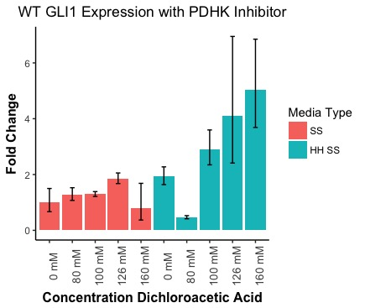
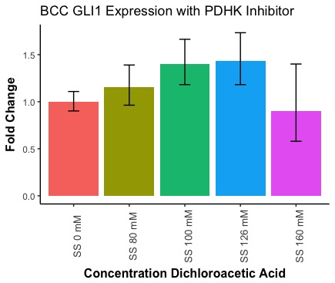
PDHK Inhibition by Dichloroacetic Acid does not activate Hedgehog Signaling
Wild Type (3T3)
BCC
Notes:
See small increase in hedgehog treated 3T3 cells but at IC50 of 80 mM the Gli expression is low
BCC does not show much change with presence of inhibitor.

Slide 13
PDHK Inhibition by Dichloroacetic Acid does not activate Hedgehog Signaling
Wild Type (3T3)
BCC
**MTT assay shows no impact on Cell Proliferation**
Notes:
See small increase in hedgehog treated 3T3 cells but at IC50 of 80 mM the Gli expression is low
BCC does not show much change with presence of inhibitor.

Slide 14
Treatment of BCC cells with PDHK inhibitor Dichloroacetic Acid does not affect cell survival
Notes:
Measuring absorbance at 570 nM as a measure of BCC cell viability when treated with drug.
Comparing the blue line (diluent only) to the other lines we do not see significant change in the absorbance at 570 nM. Overall, do not see a significant effect on the cell viability for BCC cells when treated with inhibitor

Slide 15
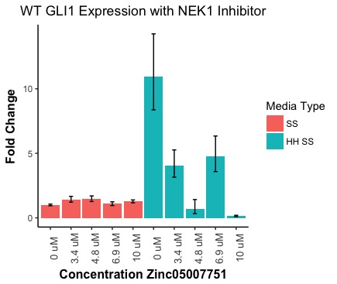
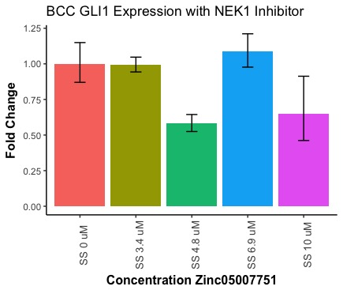
Zinc qPCR
Wild Type (3T3)
BCC

Slide 16
Zinc qPCR
Wild Type (3T3)
BCC
**MTT assay shows no impact on Cell Proliferation**

Slide 17
Treatment of BCC cells with NEK1 inhibitor Zinc05007751 does not affect cell survival
Notes:
Measuring absorbance at 570 nM as a measure of BCC cell viability when treated with drug.
Comparing the blue line (diluent only) to the other lines we do not see significant change in the absorbance at 570 nM. Overall, do not see a significant effect on the cell viability for BCC cells when treated with inhibitor

Slide 18
Future Directions

